Slide 1
Nielsen MARKETPLACE PILOT
Solution architecture

Slide 2
Nielsen MARKETPLACE pilot
Objectives
Build a working model of an API to share basic Nielsen Data with limited developers (RedLaser)
Test out assumptions we can generate a consumer friendly product name, acceptable pricing and effective availability
Test out services and the business rules such as non-releasable retail info
Understand the potential hits/usage of our data for consumer apps which should help inform any future pricing strategy
Begin to catch any missed requirements early, before the final solution is built

Slide 3
Product availability api
Overview & Scope
Product availability API provides the estimated availability of a given product along with channel / market in retailer locations in a given radius based on the consumer location
Product availability will be calculated using the scanning or retail Point-of-Sale data available in the syndicated US factory (AOD Core) that is refreshed once in 2 weeks
Products will be included only from releasable stores based on retailer agreements
For the purpose of PILOT, only 5 US commodity categories are included that are most wanted by Redlaser based on past scans
Redlaser will federate the API calls from their back end API.

Slide 4
Non-functional requirements
Total API request volumes per day are expected to be
400K, on a regular day
1 million, during holidays
API will be configured with the following plan
50 per sec throttling
50K per hour quota
10M call limit / per month with API platform provider
Response time for a request should be less than a second

Slide 5
Key soLUTION ASSUMPTIONS
PILOT duration is 6 months. Nielsen can only have a TIBCO API Exchange Platform
AOD CORE is the only data source used for the API for the PILOT. This solution is applicable only to PILOT and cannot extend to the larger DDE needs.
Data required for Marketplace will be extracted from AOD directly, without going through the spec'ing process.
AOD CORE updates are bi-weekly. API will be delivering availability that is 2 weeks old.
For performance reasons, calculations and transformations will be performed outside AOD CORE, in the MarketPlace Netezza server, after extracting the base data from AOD.

Slide 6
Key solution ASSUMPTIONS (CONTD.)
Data required by the API will be copied to multiple Netezza servers and the API traffic will be balanced across these servers.
Dynamic Load Balancer (DLB) component will be used to identify the least loaded Netezza server suited to execute incoming query.
AOD service delivery will find a set of Netezza Servers that will meet the NFRs of Nielsen MarketPlace. MarketPlace will be responsible for periodically extracting required data from AOD CORE and refreshing all the target Netezza servers with the data necessary for the API.
No additional infrastructure will be purchased for Nielsen MarketPlace, either shared platforms or AOD servers will be used.
The throttle/call limits are agreed by Redlaser and the MarketPlace Team
The initial phase of the API will provide absolute distance between the consumer location and the store.

Slide 7


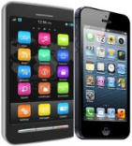



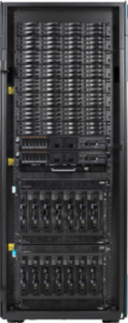
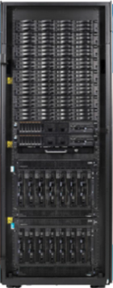



SOLUTION ARCHITECTURE
App/API
Layer
TIBCO API Exchange
Management Portal
Traffic Manager
Developers
End Users
Product Search App
Product Availability API
Web Server
TIBCO BW
(Rest Plug-in)
Data Layer
AOD
MarketPlace
Managed File Transfer Platform
Data Extraction
Releasable Stores
AOD Core/Planners
MarketPlace DB
Data Replication
MarketPlace DB
. . . . .
Market Masters Mainframe
AOD Syndicated (Production)
MarketPlace Netezza 1
. . . . .
MarketPlace Netezza n

Slide 8
Solution architecture - details
Marketplace data requirements
Product dimension:
Include only the products from 5 Pilot competitive categories -
CEREAL-READY TO EAT SPORT DRINK WATER-BOTTLED-NONCARBONATED FACIAL TISSUE HAND & BODY LOTION-ADULT
Exclude Private Label Items in these 5 competitive categories
Include only the product characteristics required in the API response and characteristics required to build product description
Store dimension:
Include releasable stores only
Include only the store characteristics required in the API response and characteristics required to compute product availability
Period dimension:
Include only the latest 4 weeks.
Facts
Restrict fact data to the above mentioned dimensions

Slide 9
Solution architecture – details (CONTD.)
Releasable Stores Load
Releasable stores file will be placed in the MFT server/folder location
Releasable stores would be loaded into a table in the AOD Core/Planners DB present in the AOD core server
This is an existing AOD process and the same would be leveraged by MarketPlace.
One time Releasable stores reference file will be provided to Redlaser
Data Extraction process
Data would be extracted from the AOD Core to the MarketPlace DB in one of the target MarketPlace Netezza Servers, say master server
The data extraction process will apply the following filters on the source data:
Stores - Include only the releasable stores
Products - Include only the available products (units > 0 in releasable stores, in the last 4 weeks) from the 5 pilot Competitive Categories
Facts - Include only the latest week sales data of available products from the 5 pilot Competitive Categories in the releasable stores

Slide 10
Solution architecture – details (CONTD.)
Computations in the Master MarketPlace DB
Following computations would be performed in the Master MarketPlace Netezza server, post the extraction process:
Compute product description for each product, based on the product’s competitive category specific algorithm
Compute Absolute distance to provide stores with in a given radius based on store and consumer location latitude/longitude coordinates.
Data Replication
The final data in the master MarketPlace DB would have the required computations performed on the filtered data
This would be replicated to the MarketPlace DBs in the remaining Netezza servers

Slide 11
Solution architecture – details (CONTD.)
Dynamic Load Balancer (DLB)
Configurations required to utilize the dynamic load balancer component must be done in advance.
Product Availability API
Product availability API will utilize Dynamic Load Balancer component to identify the least loaded Netezza server available to execute the query and direct the query to it
Product availability API will do the following:
Find products matching the search criteria
Find stores within a given radius (absolute distance) that are selling the matching products
Return absolute distance to the stores found (above) based on store and consumer location latitude/longitude coordinates.

Slide 12
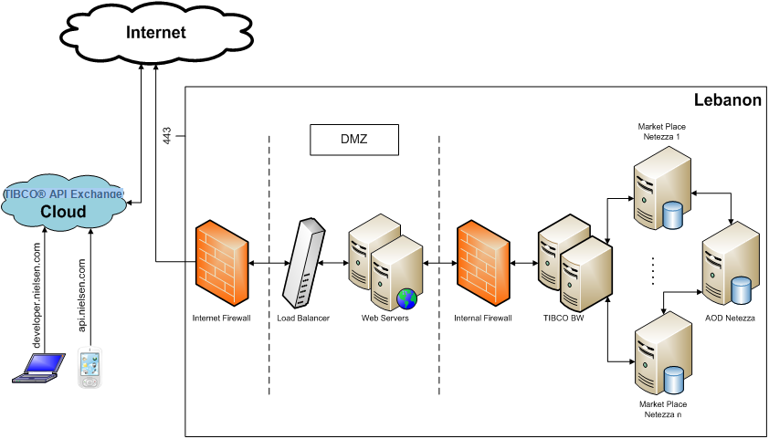
Physical architecture

Slide 13
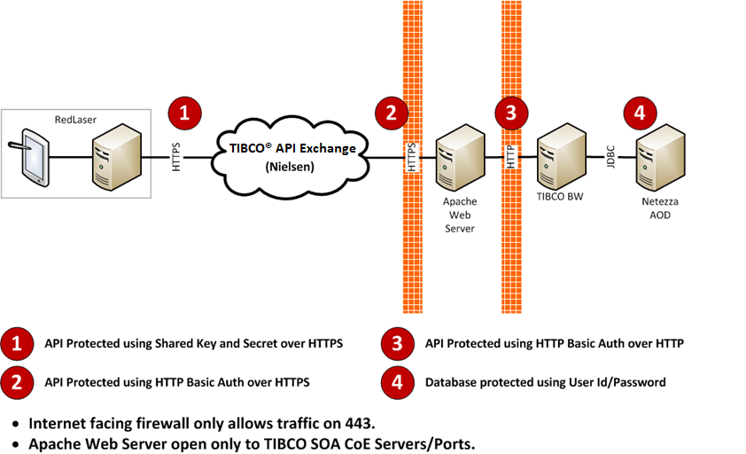
Security architecture

Slide 14
OPEN QUESTIONS
Refresh Frequency
AOD Core/Syndicated database is currently updated on a bi-weekly schedule. So Marketplace data sync up will be done bi – weekly basis as like AOD Core

Slide 15
Component list – HARDWARE
Hardware Components
Component Name | Description | Technology
Netezza DB Servers (AOD & MarketPlace) | Netezza database server hosting AOD Planners production database and MarketPlace Netezza server hosting the target MarketPlace DB | Netezza Database Server
MFT Server | TIBCO Managed File Transfer (MFT) server, where the releasable stores file will be received from Market Masters mainframe | FTP Server
Application Server | Server hosting product availability services and exposes them as RESTful services, using the REST plugin | TIBCO BW
Web Server | Web server hardware | Apache Web Server

Slide 16
Component list – THIRD PARTY SOFTWARE
Third Party Software Components
Component Name | Description | Technology | Complexity
API Management Portal | Developer portal where developers can register API, configure and control access plans and monitor usage | TIBCO API Exchange -Management Portal | Medium
API Traffic Manager | Proxy/gateway that authenticates/authorizes incoming API requests, controls access based on the access plan, throttles and redirects requests to Nielsen | TIBCO API Exchange - API Gateway | Medium
Apache Web Server | Handles HTTP requests | Web Server | Medium
TIBCO AMX BW | Hosts product availability services and exposes them as REST | Application Server | Medium
MFT | TIBCO Managed File Transfer (MFT) software to receive releasable stores file | TIBCO MFT | Low
Dynamic Load Balancer (DLB) | A custom JAVA component developed in-house to balance load across a set of Netezza servers. Keeps track of the actual load on individual Netezza servers based on the queries being executed on it and determines the least loaded Netezza server to execute the incoming query. | Load Balancer | Low

Slide 17
Component list – SOFTWARE
Software Components to be developed
Component Name | Description | Technology | Complexity
Data Extraction & File Transfer | Process that Extract the data from the AOD Core Netezza server & store in text files . | nzsql/shell scripts | Medium
File Transfer | File Transfer scripts, which receives the AOD file from Market Masters mainframe and transfers it to AOD Core DB | nzsql/shell scripts | Medium
Pre-computation | Performs product description generation and average price computation | nzsql/shell scripts | Medium
Data Replication | Copies the pre-computed data from Master MarketPlace DB to the remaining MarketPlace DB instances | nzsql/shell scripts | Medium
Product Availability API | Invokes Dynamic Load Balancer to identify the Netezza server to execute the query. Provides the estimated availability of a given product in retailer locations in a given radius based on the consumer location, by querying MarketPlace DB. Computes absolute distance to the store. | Java Web Service | Medium

Slide 18
PROCESS FLOW
AOD Refresh Process
AOD bi-weekly Dimension Refresh/build process
Receipt of Releasable Stores file from Mainframe
1
Load Releasable Stores into a table in the MarketPlace DB present in the AOD core server
One time Releasable Stores Transfer to Redlaser
Releasable Stores Load
2
Data Extraction
Extract data from AOD Core to the Master MarketPlace DB in the MarketPlace Netezza server
Apply releasable stores and product availability filters
3
Pre-computation
Generate product description
4
Data Replication
Copy the pre-computed data from Master MarketPlace DB to the remaining MarketPlace DB instances
5
Invoke DLB to identify least loaded query target(Netezza server)
Find products matching the search criteria
Find stores within a given radius (absolute distance) that are selling the matching products
Compute absolute distance to the store
Product Availability API
6

Slide 19
DATA MAPPING – Products
API Response vs AOD Column Mapping
API RESPONSE |  | AOD Column (PRDC_DIM table)
Data Element | Description | Column Name | Description
Product ID | Unique identifier for the product. | PRDC_CODE | 13 Digit UPC (PRDC_CODE)
Product name | Consumer friendly product name |  | To be generated using a description generation algorithm
Manufacturer Name | Name of the product manufacturer | BE_HIGH | BRAND OWNER HIGH
Bar code | Product identifier such as UPC, EAN etc. | PRDC_CODE | 13 Digit UPC (PRDC_CODE)
Category | Competitive category | CTG_DFL_NM | COMPETITIVE CATEGORY
Brand | Product brand description | BRN_HIGH | BRAND HIGH
* Column names in red indicate that they are yet to be confirmed.

Slide 20
DATA MAPPING – retailers & Location
API Response vs AOD Column Mapping
API RESPONSE |  | AOD Column (STR_DIM table)
Data Element | Description | Column Name | Description
Retailer Name | Retailer name of the store | SNAME | Retailer Name( SNAME )
Store ID | Unique identifier of the store | SORGCD + SPSUEDOCD | SORGCD + SPSUEDOCD – natural Key
Store Number | Store Number | SNO | Store Number(SNO)
Store Name | Store Name | SNAME | Store Name
Address Line 1 | Store Address Line 1 | SSTREETADD | Street Address
Address Line 2 | Store Address Line 2 | Not Available
City | Store City | SCITY | City
State | Store state | SST | State
Zip | Store zip/postal code | SZIP | ZIP Code

Slide 21
DATA MAPPING – retailers & Location (CONTD.)
API Response vs AOD Column Mapping
API RESPONSE |  | AOD Column (STR_DIM table)
Data Element | Description | Column Name | Description
Country | Store country | Not Available | USA – Hard coded
Phone Contact | Contact number of the store | SAREACD-SPHONENO | Area Code-Phone Number(SAREACD-SPHONENO)
Latitude | Store Latitude | SLAT | Latitude
Longitude | Store Longitude | SLONG | Longitude
Distance | Absolute Distance from the given latitude/longitude of the location to the store | Not Available | Absolute distance calculated , to provide stores within Radius from a given Lat / Long

